Slide 1
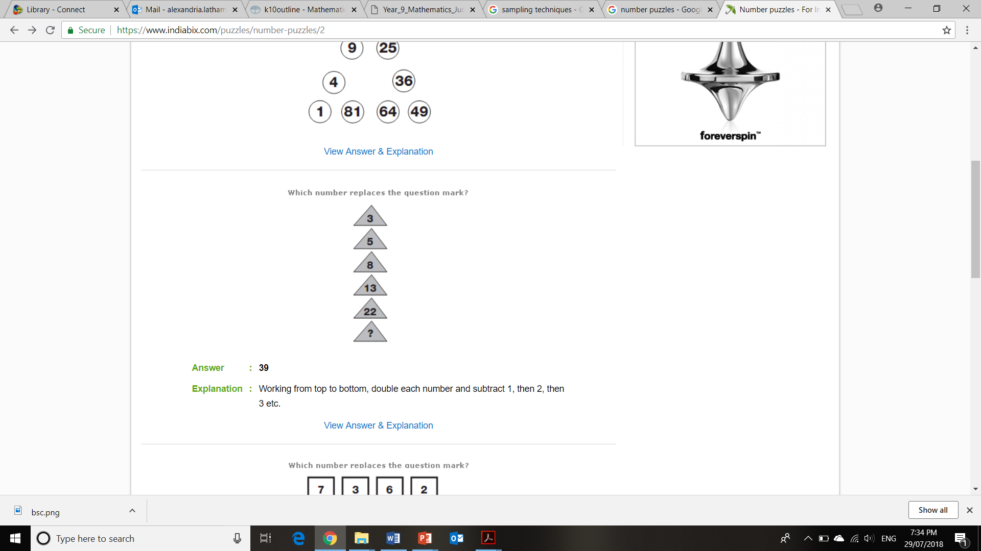
Topic: Adding and Subtracting Fractions
Topic
EQ
Rule up your page like this!
Summary
EQ: How can we develop a visual model for adding and subtracting fractions?
Ms. Latham

Slide 2
Add a Slide Title - 1

Slide 3
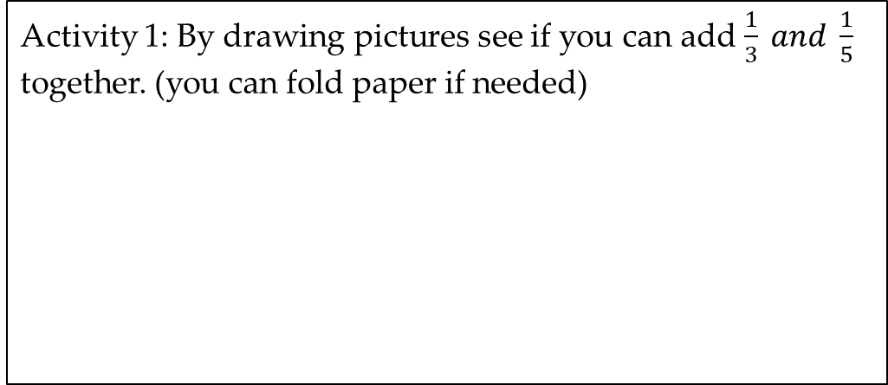
Topic: Adding and Subtracting Fractions
EQ: How can we develop a visual model for adding and subtracting fractions?
Activity 1: By drawing pictures see if you can add $\frac{1}{3} and \frac{1}{5}$ together. (you can fold paper if needed)
Work with your group to decide if this representation is wrong, and why??
Notes:
Check out the common misconceptions chart on the document.

Slide 4
2 volunteers (who are very good at folding paper)
Picture representation of adding fractions (you draw what is on the board into your books!)
Notes:
Have one student fold a paper into thirds (longways – hotdog) and another student fold a paper into fifths (shortways or hamburger)
Take them up to the board and draw them separately.
Combine the shapes and discuss as a class what should be done about the leftover part (it is counted twice so we should probably move it.

Slide 5



Can we do the same thing again?
Try the same process for adding:
$$\frac{1}{3}+ \frac{1}{4}$$
$$\frac{1}{4}+ \frac{1}{5}$$
Extension:
$\frac{2}{5 }+\frac{1}{4}$ and $\frac{2}{3}+\frac{1}{2}$
Notes:
Kids that understand what they are doing let them loose on these ideas and encourage to try the extension questions.

